Slide 1
Olist E-Commerce Company Analysis

Slide 2
Project analysis slide 2
Project Process
Extract Data
KPIs & Visualization
PROJECT
Transformation
Dashboard
Load & Using Tools

Slide 3
Project analysis slide 4
Project Analysis
RAW DATA
CLEAN DATA
Database
Normalization
Data Storage through multiple CSV files
Reduce data storage
ETL Process
Optimization
Analytics Insights
Inefficient information
Create a normalized relation as a central data to collect files in a Workbook
Create efficient
Query and analysis
Conduct data manipulation and data cleaning with Excel and MySql
Lack of analytics insights to make business decisions
Empower data driven decision making capability
Generate analytical insights through an interactive dashboard via Power BI, Tableau

Slide 4




Project analysis slide 3
Working On Raw
Dataset Details
Import
Files
Treatment Of Repetitive columns
Remove Duplicates
Manage Relation among dataset
Prepare Data For Analysis
9 Flat CSV files:
1. Customers
2. Geolocation
3. Order Items
4. Order Payment
5. Order Review
6. Orders
7 Products
8. Sellers
9. Category file
After cleaning, removing duplicates, merging, appending, and managing relations calculate some measures and KPIs for Visualization
In the Geolocation file and Customer file there are repetitive columns like city, state, and Zip code merge them.
The geolocation dataset has underlying “duplicates” which drop through the Excel function to remove duplicates.
With the help of power pivot use a data model to manage the relationship between all files with their primary keys in Excel

Slide 5
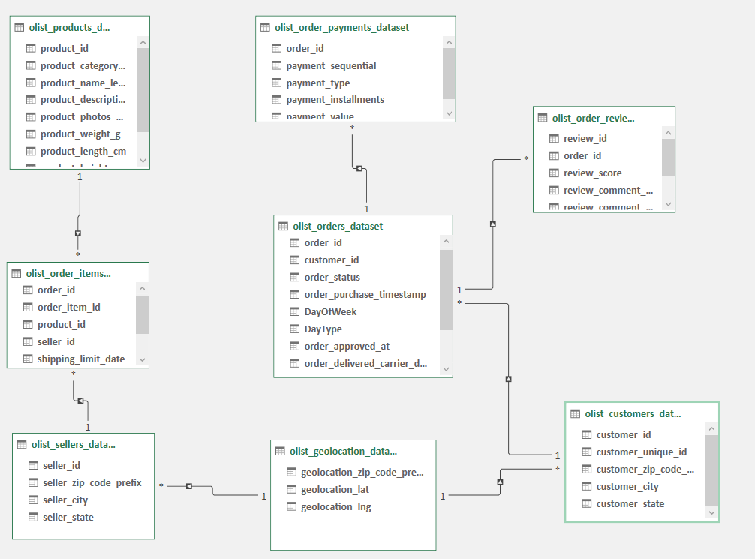
Project analysis slide 5
Manage Relation
Between Datasets
By combining all primary keys and foreign keys, a relationship has been established among the various datasets.

Slide 6
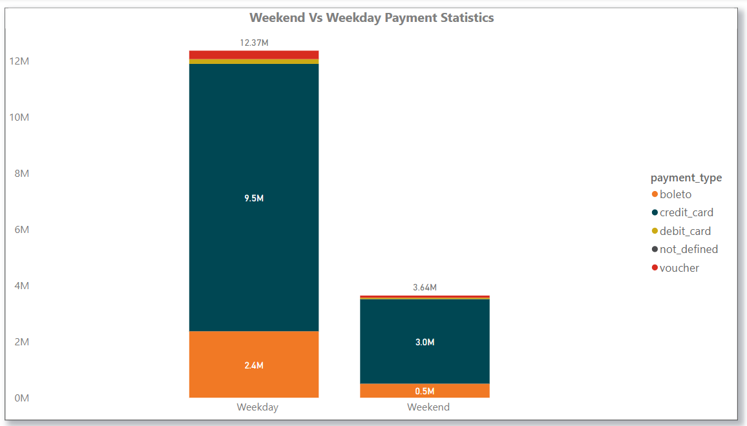
Project analysis slide 5
KPI 1st Weekday Vs Weekend (order_purchase_timestamp) Payment Statistics
Weekdays
Weekend
Day Wise Transactions
Payment Type
Payment Type
Total Transaction = 103886
Baleto- 2.4 Million earning
Credit Card- 9.5 Million, which is the highest earning between both weekdays and Weekends.
Debit Card & Voucher- They hold a small portion of it.
Baleto- 0.5 Million earning
Credit Card- 3.0 Million, which is the highest earning between both weekdays and Weekends.
Debit Card & Voucher- They hold a small portion of it.
Highest transaction placed on Monday which is 16875
Lowest transaction placed on Saturday which is 11379

Slide 7
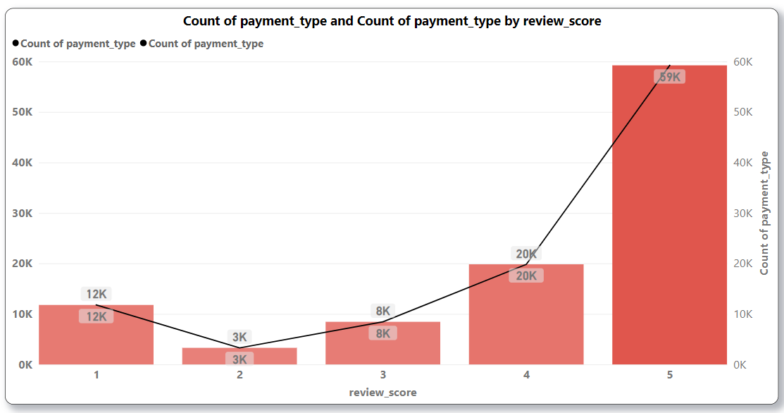
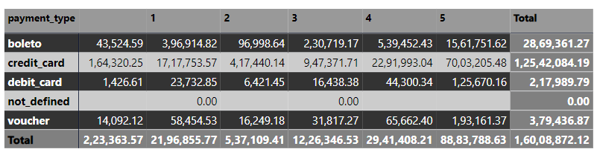
Project analysis slide 6
KPI 2nd
Number of Orders with a review score of 5 and payment type as a credit card
.
The credit card payment method has consistently shown the highest payment amount across all reviews, with the top payment received in five reviews.
As indicated in the chart above, it can be observed that Review 5 reflects a payment value of 59k, denoting the highest payment amount among all reviews.
As per the table provided, the payment amount of 7003205.48 reflects the highest value and has been made through the credit card payment method. Additionally, the corresponding review score for this payment is 5.

Slide 8
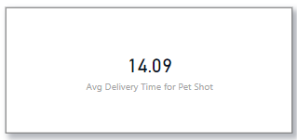
Project analysis slide 7
KPI 3rd & KPI4th
The average number of days taken for order_delivered_customer_date for pet_shop & Average price and payment values from customers of sao paulo city
Average Delivery Time For Pet Shop
According to the chart displayed, the average payment value for the city of Sao Paulo is 154.100.
As illustrated in the chart, the average payment value for Sao Paulo city is 154.100.

Slide 9
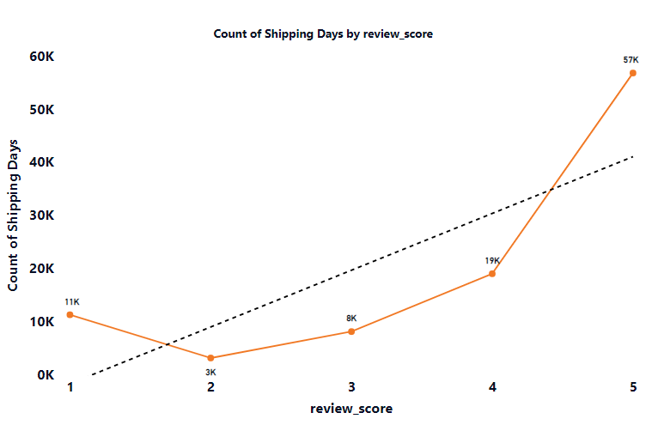
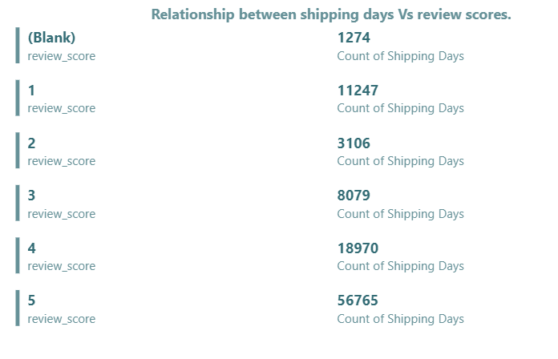
Project analysis slide 7
KPI 5th
Relationship between shipping days (order_delivered_customer_date - order_purchase_timestamp) Vs review scores.
Both the line chart and the multiple cards indicate that a review score of 5 is associated with a longer shipping duration as compared to the other review scores.

Slide 10
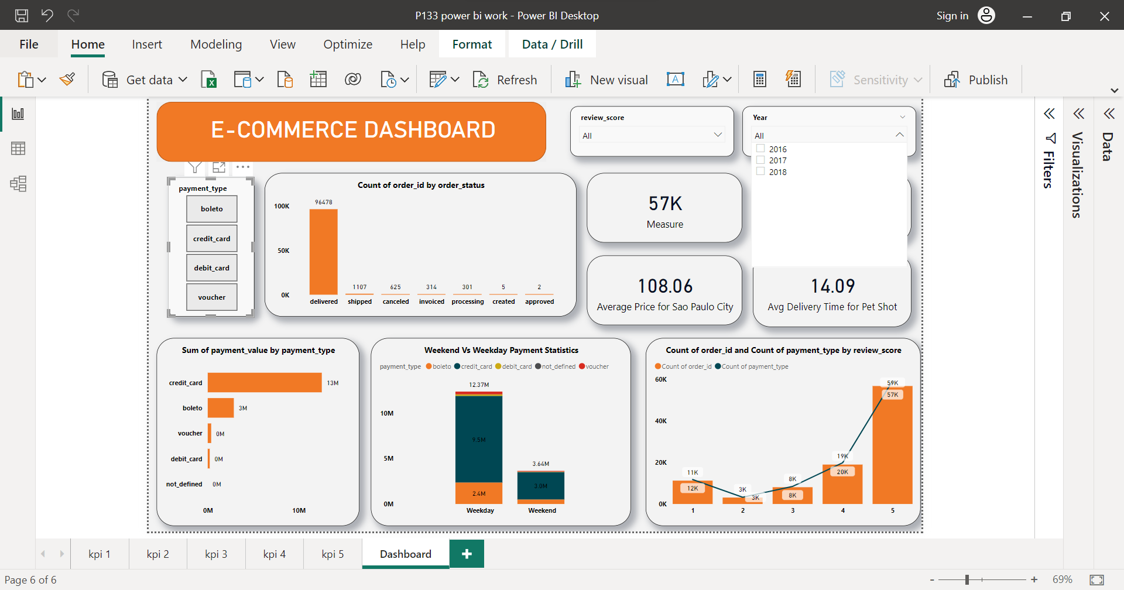
Project analysis slide 7
^{DASHBOARD}

Slide 11
Project analysis slide 7
^{DASHBOARD}

Slide 12
Thank You

